Slide 1
Competitor Analysis

Slide 2
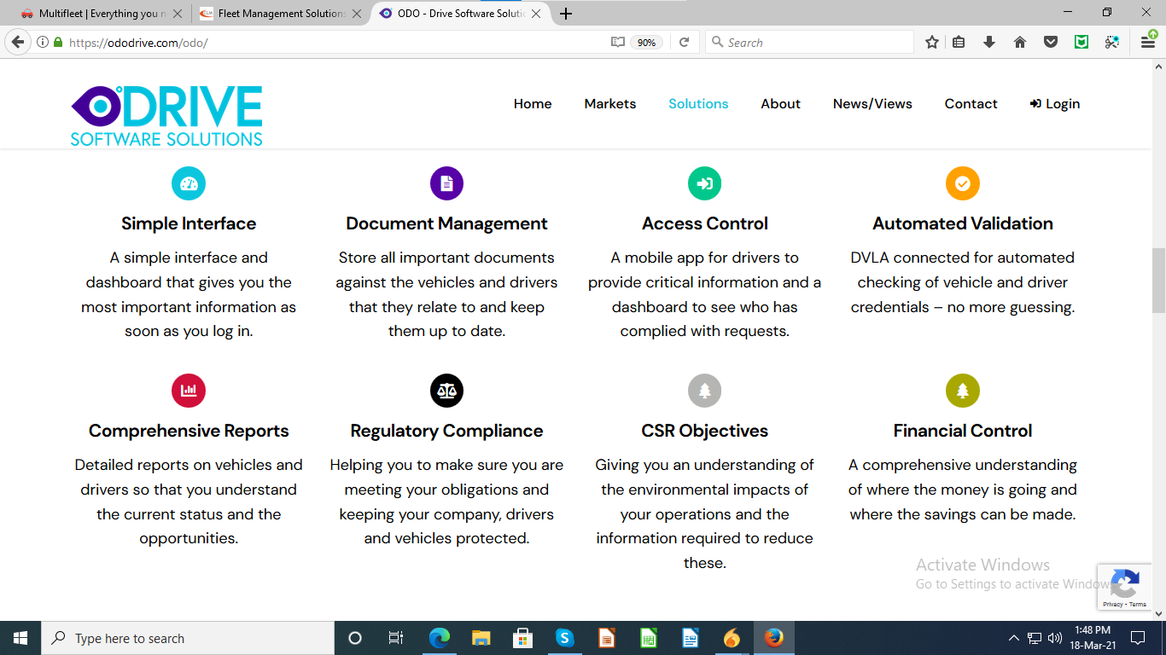
OdoDrive
Some features of app are stated.

Slide 3
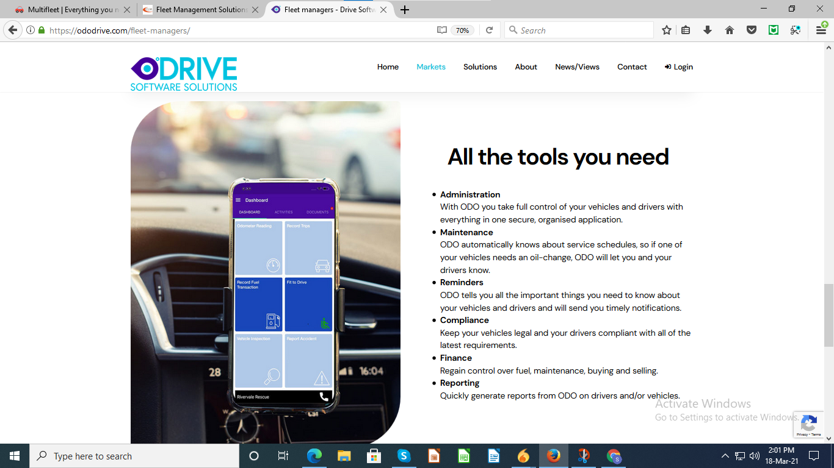
OdoDrive
Glimpse of application is given.

Slide 4

CLM
Feature of online service booking is given

